Slide 1
Heart Disease Prediction
Using Personal Key Indicators

Slide 2
Table of Contents
01
02
03
04
Problem Overview
Approach
Data Preparation
05
Modelling & Evaluation
Unsupervised Learning

Slide 3
“And they say, XGBoost is all you need.”
—Someone Famous

Slide 4
01
Problem Overview
Introduction, Dataset Walkthrough

Slide 5

Introduction
Heart disease is one of the biggest causes of morbidity and mortality among the population of the world. Prediction of cardiovascular disease is regarded as one of the most important subjects in the section of clinical data analysis.
Data source. Collected as part of annual telephone surveys
400K
Adults’ data related to health status
18
Personal Key Indicators as Features

Slide 6
Dataset Overview
Features | Type | Description
BMI | Numerical | Body Mass Index (BMI)
Smoking | Categorical | Smoked at least 100 cigarettes in your entire life
AlcoholDrinking |  | Heavy drinkers (adult men > 14, adult women > 7 drinks per week)
Stroke |  | Had a stroke
PhysicalHealth |  | Number of days the physical health not good (30 days)
MentalHealth |  | Number of days the mental health not good (30 days)
DiffWalking |  | Serious difficulty walking or climbing stairs
Sex |  | Male or Female
AgeCategory |  | Fourteen-level age category
Race |  | Imputed race/ethnicity value
Diabetic |  | (Ever told) (you had) diabetes?
PhysicalActivity |  | Adults who reported doing physical activity or exercise during the past 30 days
GenHealth |  | Would you say that in general your health is...
SleepTime |  | On average, how many hours of sleep do you get?
Asthma |  | (Ever told) (you had) asthma?
KidneyDisease |  | Whether the person has Kidney Disease
SkinCancer |  | (Ever told) (you had) skin cancer?

Slide 7
Sub-tasks
1
2
Classification Problem
Clustering Problem
Use Personal Key Indicators and classify whether they have heart disease or not
Perform Data Preparation, Modelling and Evaluation
Drop Heart Disease Label and perform Clustering
Detect outliers in the data, remove them
Perform clustering on the clean data and label them
Compare it with the actual label

Slide 8
02
Approach
Label Prediction
Classification Problem

Slide 9
Process Flow
Classification Problem
Modelling
Ensembling
01
Common Eval. FW
Gridsearch, CV
Evaluation Metric
Split-based Models
Combine the tuned models
EDA
02
Unsupervised Learning
Exploratory Analysis
Preparation
Dim. Reduction
Feature-splits
Outliers
Clustering
Perform K-means, DBScan, GMM, BIRCH
Drop Labels
Isolation Forest
DBScan

Slide 10
Ensembling
(Three Models)
0.846
Ensembling
(Two Models)
0.804
Individual
0.765
HistGradient + SVC Linear+ KNC
TabNet + SVM RBF
TabNet
Best ROC

Slide 11
03
Data Preparation
Data Wrangling, Exploratory Analysis, Dimensionality Reduction Scaling, Encoding

Slide 12
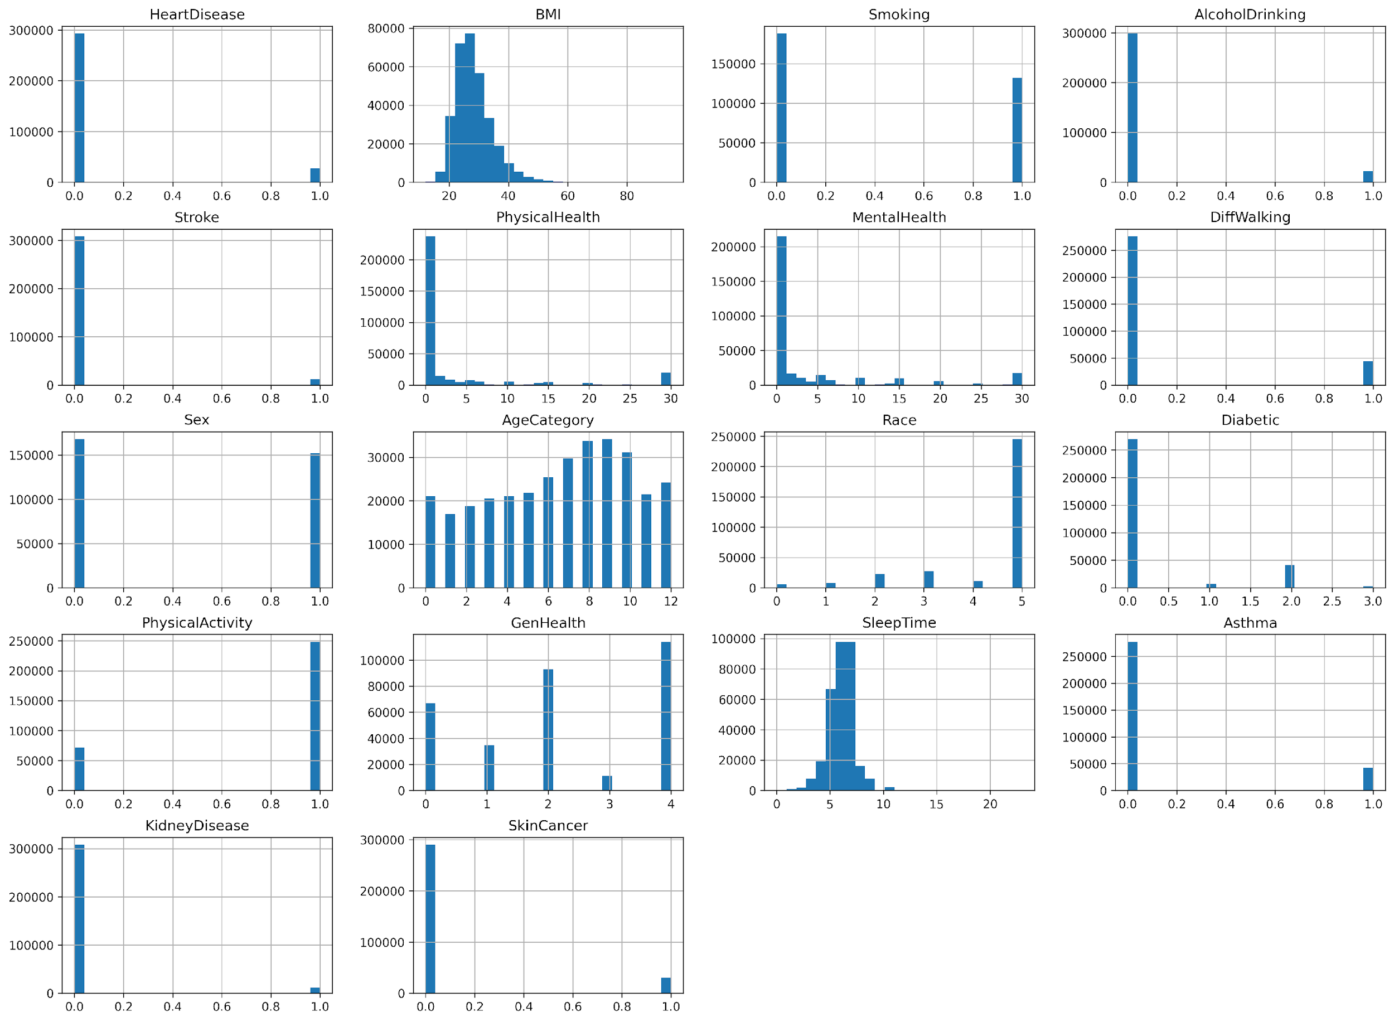
Histograms 1/2

Slide 13
Histograms 2/2

Slide 14
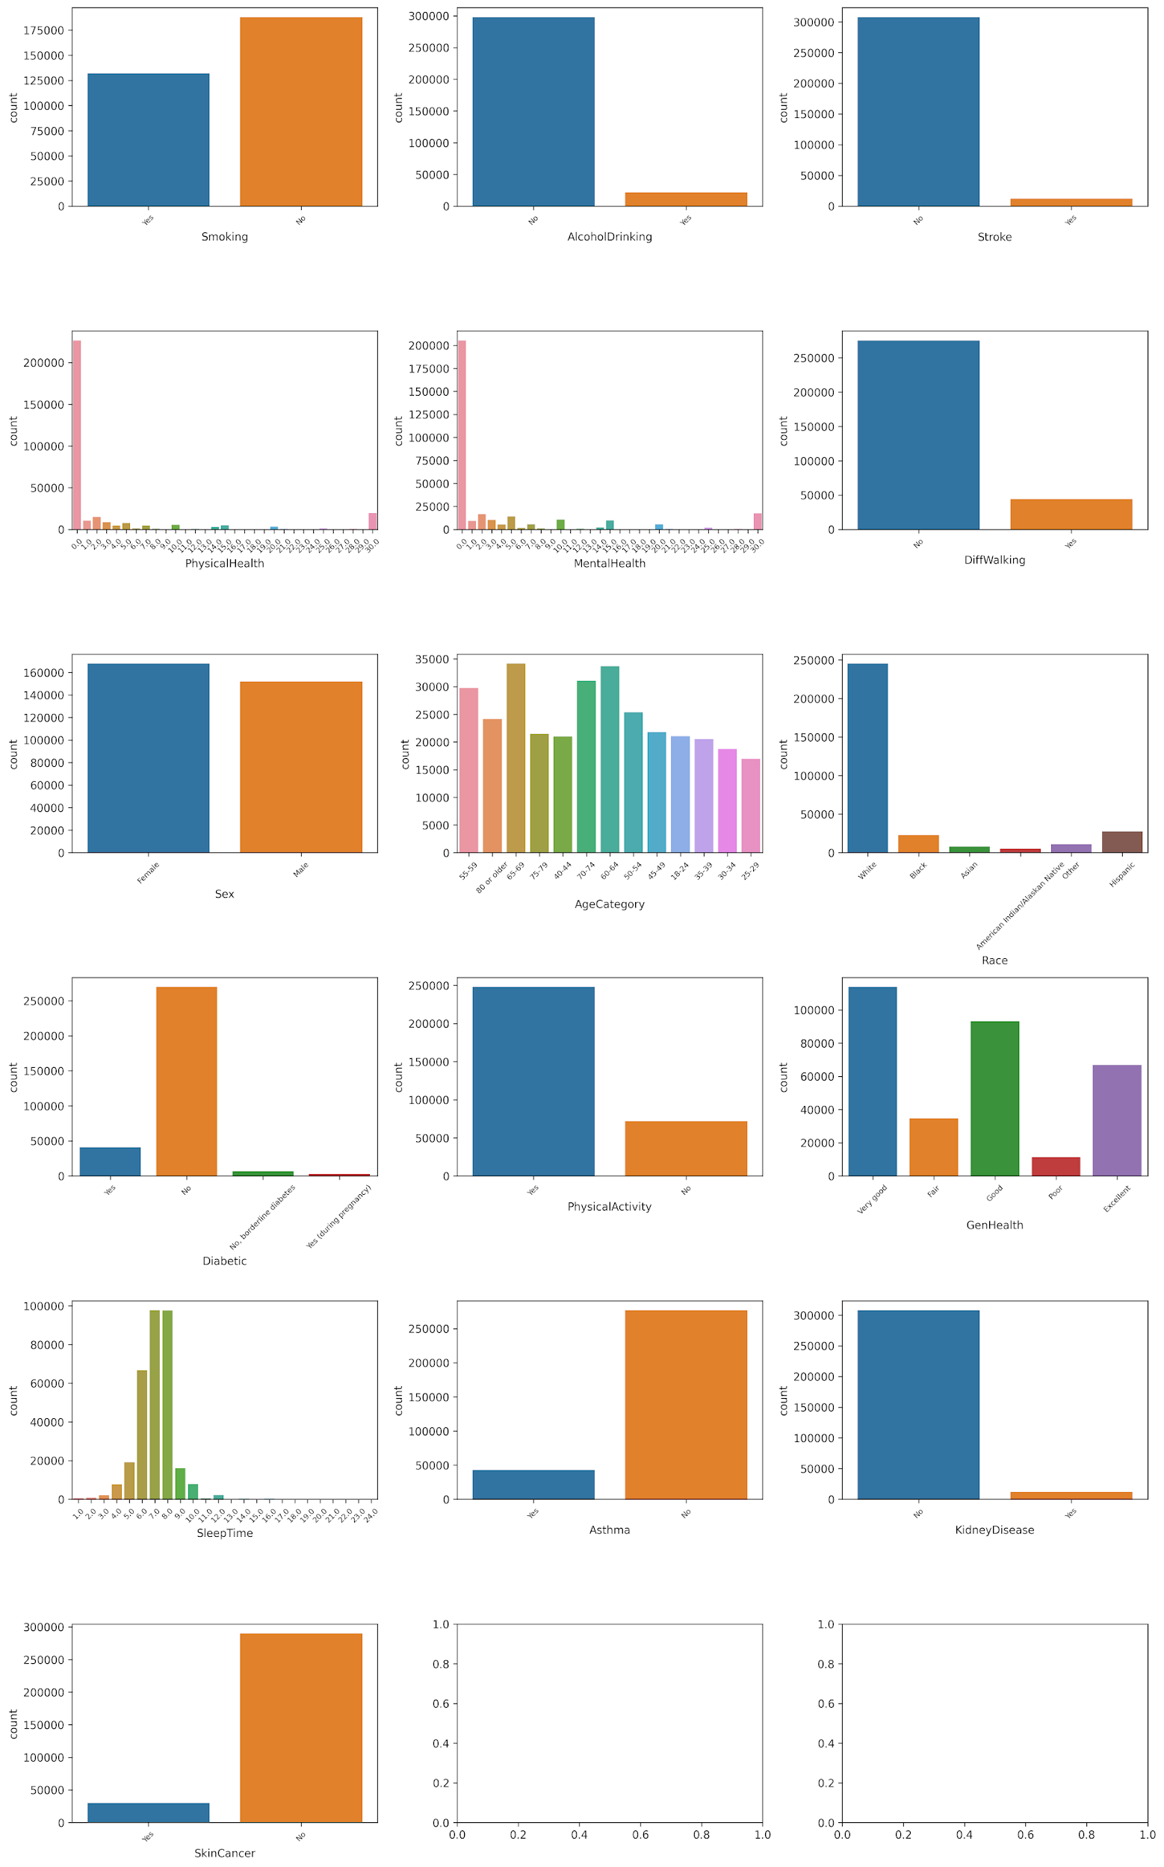
Categorical Countplot 1/2

Slide 15
Categorical Countplot 2/2

Slide 16
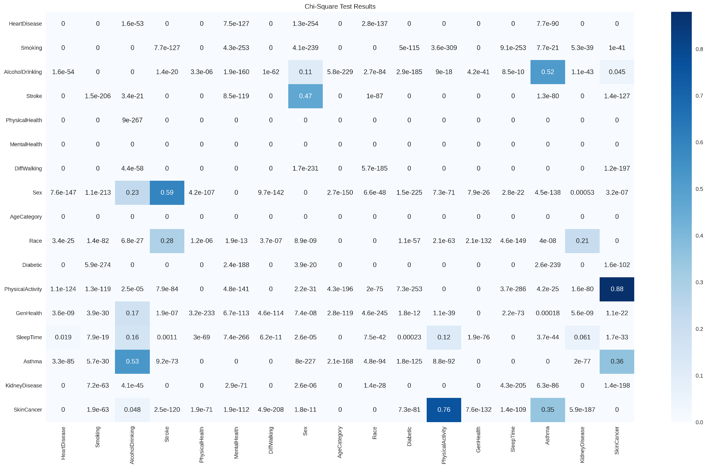
Categorical Correlation
Chi Square Test

Slide 17
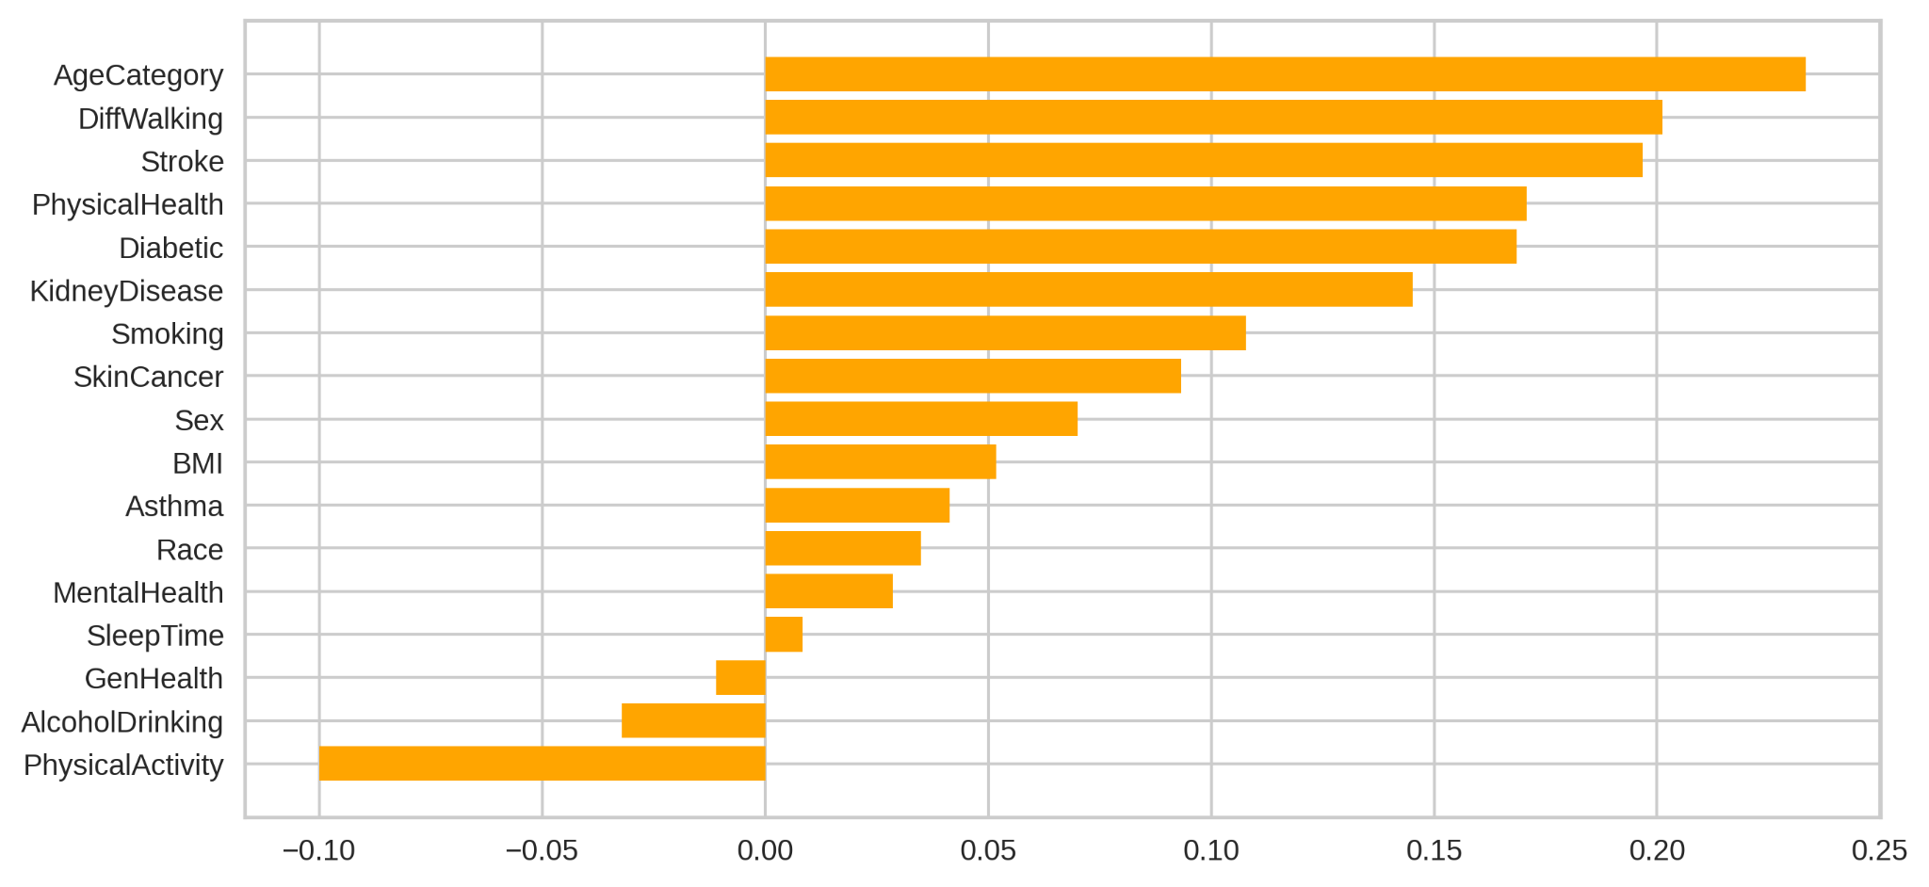
Correlation with Target

Slide 18
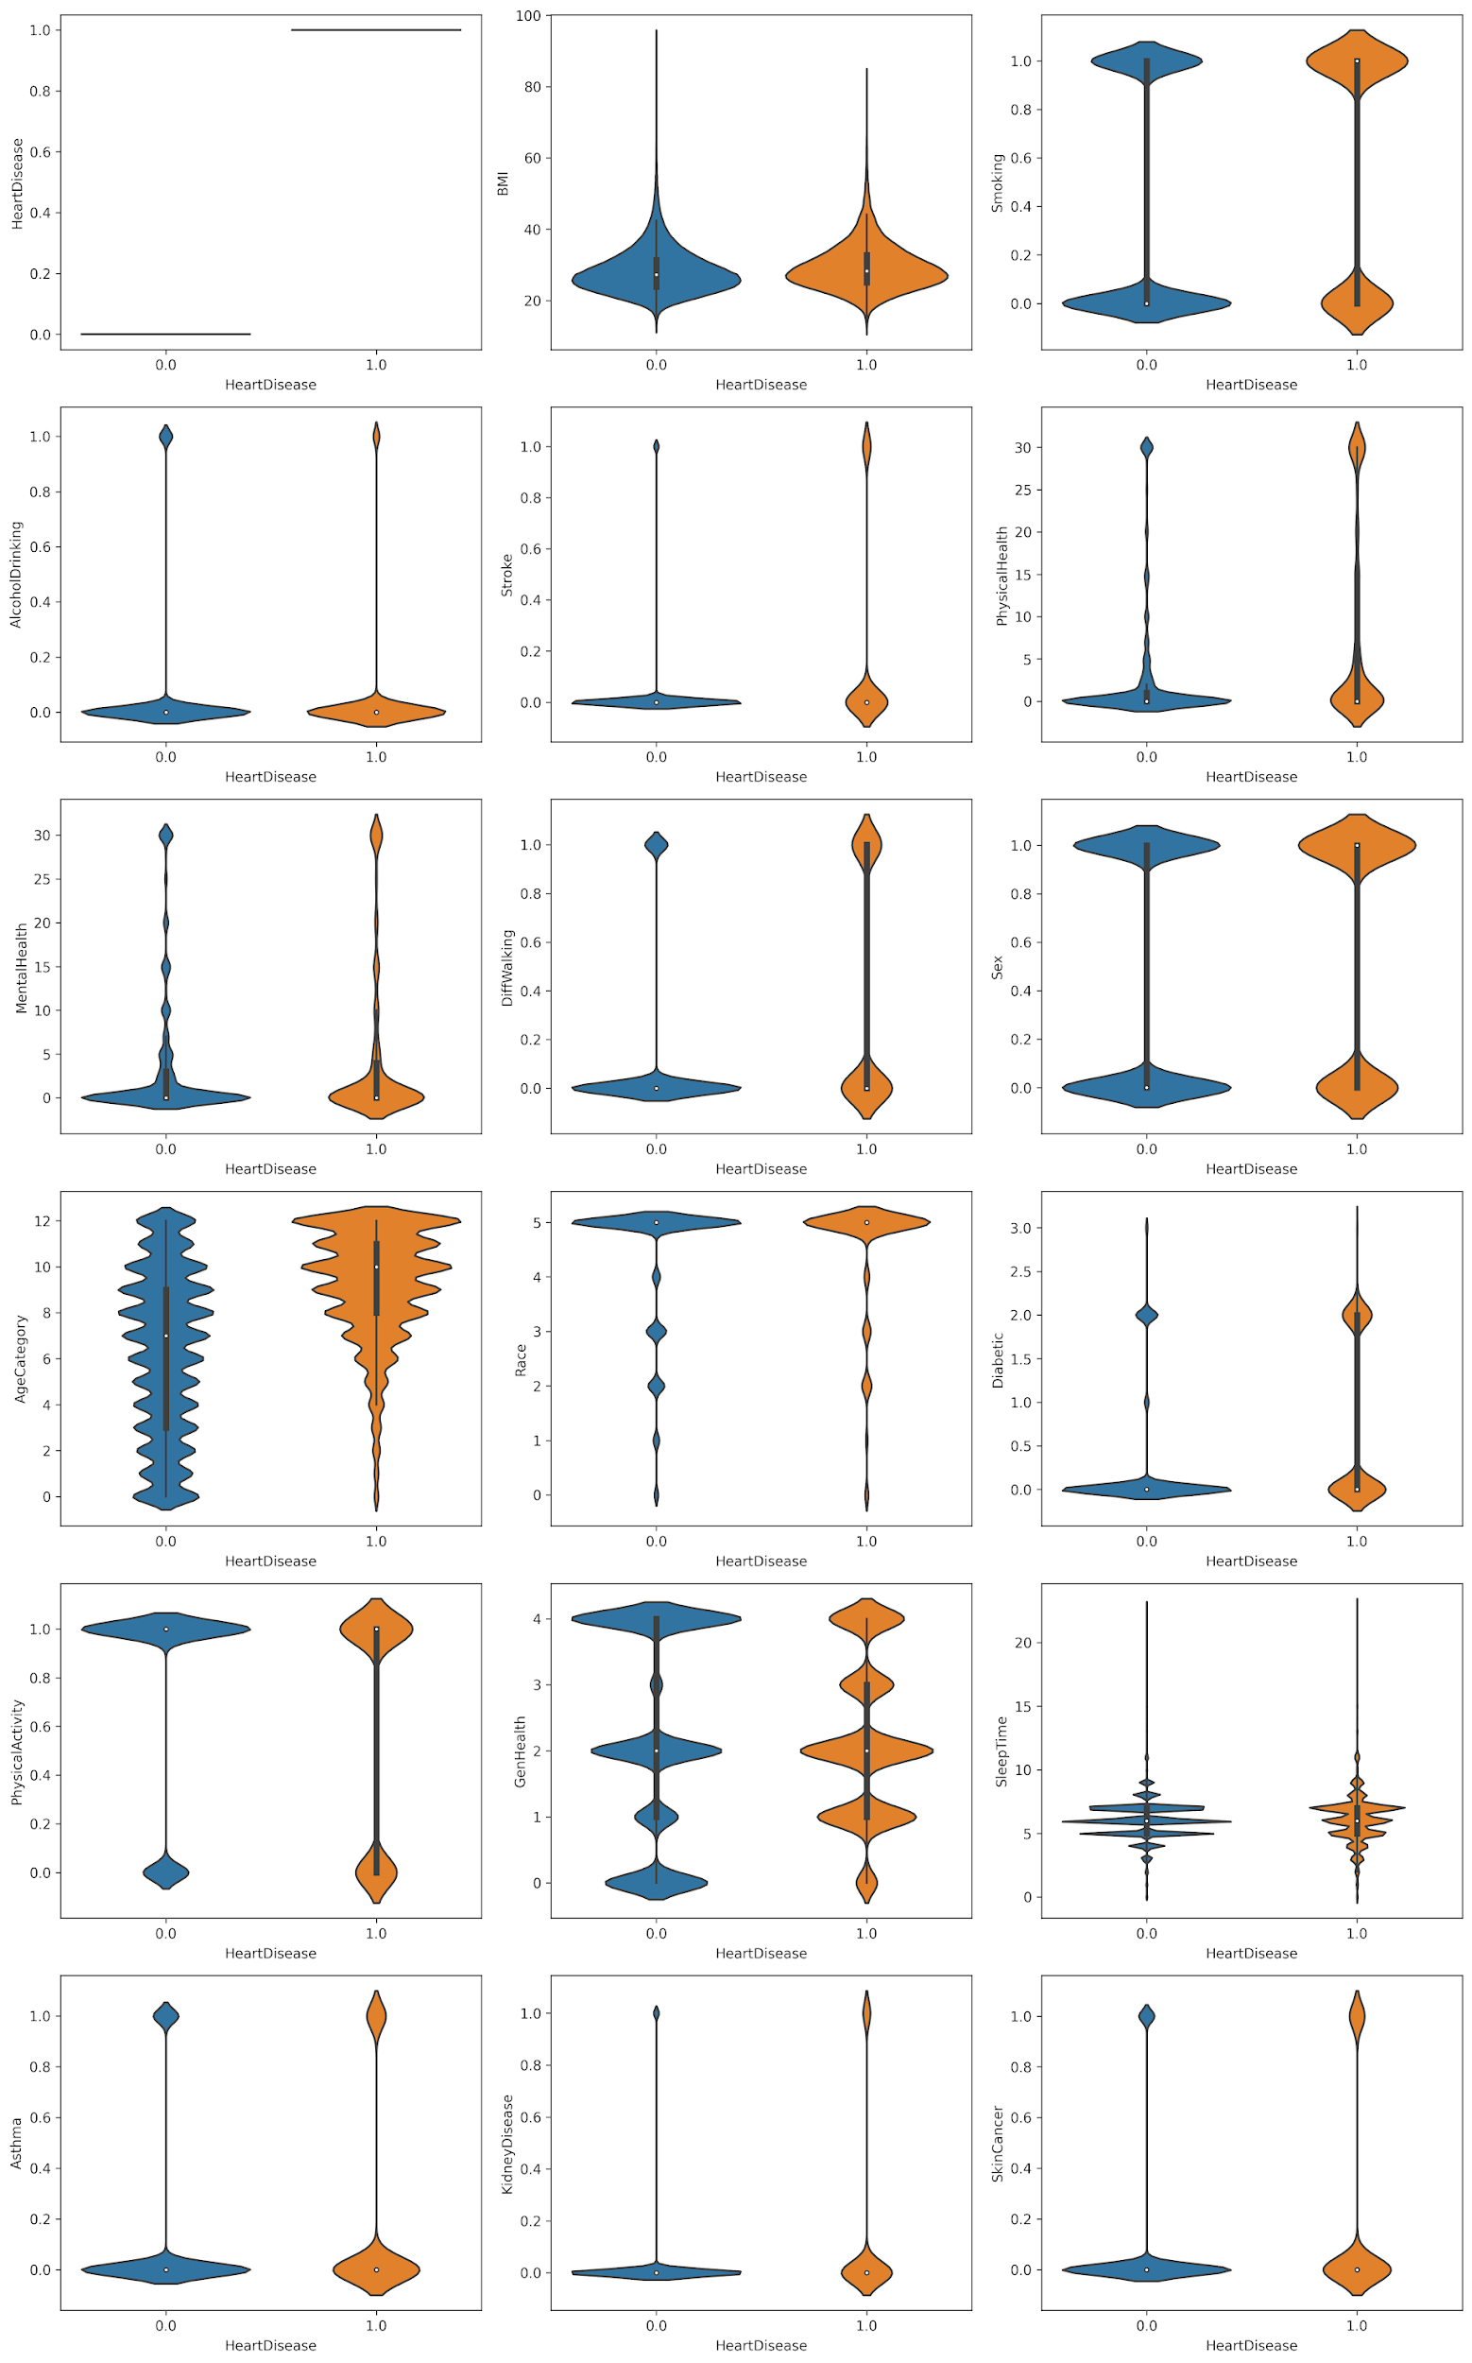
Violin Plot with Target Classes

Slide 19
Violin Plot with Target Classes

Slide 20
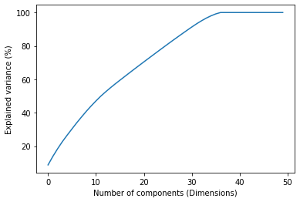
Dimensionality Reduction
After OHE, the feature columns increased to 49
From the explained variance plot, we identified multicollinearity.
Using PCA, we reduced the dimension to 36.
However, for certain models, we ignored PCA as it reduced the ROC

Slide 21
04
Modelling
Common Evaluation Framework
Split-based Modelling
Ensembling

Slide 22
ML Modelling Process
Choose Model
Cross Validation
Ensembling
Experimented with 15+ models.
Efficient use of training data
Combine the best models for better result
01
02
03
04
05
Grid Search
Evaluation
Choose the right hyper params and run GridSearch
Use F1 as the metric for choosing the best model

Slide 23
Performance Analysis 1/3
Algorithm | Parameters | Accuracy | ROC
Logistic regression | {'C': 0.1} | 0.9141 | 0.5542
Logistic regression(pruned) | {'C': 0.1} | 0.9133 | 0.5626
KNC | {'n_neighbors': 14} | 0.9135 | 0.5300
KNC(pruned) | {'n_neighbors': 14} | 0.9138 | 0.5123
Random Forest | {'class_weight': 'balanced', 'max_depth': 20, 'max_features': 'log2', 'min_samples_leaf': 80} | 0.6988 | 0.7624
SVM - linear | {'C': 1, 'kernel': 'linear', 'max_iter': 1000, 'probability': True} | 0.4354 | 0.5588
SVM-RBF | {'C': 10, 'gamma': 'auto', 'kernel': 'rbf', 'max_iter': 1000, 'probability': True} | 0.9217 | 0.5109
SVM-poly | {'C': 1, 'degree': 2, 'kernel': 'poly', 'max_iter': 1000, 'probability': True} | 0.08875 | 0.4721
ExtraTrees | {'class_weight': 'balanced', 'max_depth': 30, 'max_features': 8, 'min_samples_leaf': 80} | 0.6917 | 0.7618
GradientBoosting | {'learning_rate': 0.8, 'n_estimators': 100} | 0.9056 | 0.5551

Slide 24
Performance Analysis 2/3
Algorithm | Parameters | Accuracy | ROC
LightGBM | {'error_score': 'raise', 'n_jobs': 4, 'refit': 'roc_auc', 'scoring': 'roc_auc'} | 0.9166 | 0.5372
XGboost | {'booster': 'gbtree', 'eval_metric': 'logloss', 'max_depth': 30, 'n_estimators': 100, 'tree_method': 'hist'} | 0.9053 | 0.5617
CatBoost | iterations': [100], 'learning_rate': [0.5], 'depth': [2], 'l2_leaf_reg': [0.5] | 0.9163 | 0.5427
ADABoost | {'base_estimator__max_depth': 10, 'base_estimator__min_samples_leaf': 10, 'learning_rate': 0.1, 'n_estimators': 50} | 0.9139 | 0.5446
Decision Tree | {'max_depth': 45, 'max_features': 25, 'min_samples_leaf': 2, 'min_samples_split': 10, 'splitter': 'best'} | 0.8958 | 0.5723
HistGradientBoostingClassifier | {'l2_regularization': 0.01, 'learning_rate': 0.3, 'max_depth': None, 'min_samples_leaf': 80} | 0.916 | 0.5425

Slide 25
Split-based Models 1/2
Feature used for Model Split | Model with best params | AUC
Smoking | Logistic Regression {C: 1} | 0.56
AlcoholDrinking | Logistic Regression {'C': 0.1} {'C': 1} | 0.56
Stroke | Logistic Regression {'C': 1} | 0.55
DiffWalking | Logistic Regression {'C': 1000} {'C': 0.1} | 0.54
Sex | Logistic Regression {'C': 10} {'C': 0.1} | 0.56
Race | Logistic Regression {'C': 1} {'C': 1} | 0.56

Slide 26
Split-based Models 2/2
Feature used for Model Split | Model with best params | AUC
Diabetic | Logistic Regression {C: 1} {C:0.1} | 0.55
PhysicalActivity | Logistic Regression {'C': 0.1} {'C': 10} | 0.57
Asthma | Logistic Regression {'C': 1} {'C': 0.1} | 0.56
DiffWalking | Logistic Regression {'C': 1} {'C': 1} | 0.55
KidneyDisease | Logistic Regression {'C': 10} {'C': 0.1} | 0.56
SkinCancer | Logistic Regression {'C': 0.1} {'C': 0.1} | 0.56

Slide 27
Exploring SVM with GPU (1/2)
Due to the large size of our data set we found SVM was taking very high time to converge. So we decided to explore how SVM reacts with GPU.
We used the module ThunderSVM which is an open-source library which leverages GPUs and multi-core CPUs in applying SVM to solve problems in a much faster way with high efficiency
We took various fractions of our data set and ran SVM with same hyper parameters with Sklearn’s SVC and ThunderSVM SVC.
We plotted noted training and prediction time.
Note: We tried this in Google colab. Since Colab does not recommend using GPU as runtime, we found ThunderSVM give strange results beyond a certain size of the data. We plotted till that limit.

Slide 28
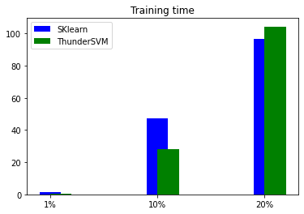
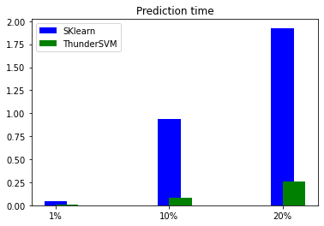
Exploring SVM with GPU (2/2)
We observed lesser training and prediction time using ThunderSVM vs SkLearn

Slide 29
Performance Analysis 3/3
Algorithm | Parameters | Accuracy | ROC
TabNet | {optimizer_fn=torch.optim.Adam, optimizer_params=dict(lr=2e-2), scheduler_params={"step_size":10,"gamma":0.9}, scheduler_fn=torch.optim.lr_scheduler.StepLR, mask_type='entmax'} | 0.7648 | 0.7651
PCA(Dim_Red)+ TabNet + Pruned_data | {optimizer_fn=torch.optim.Adam, optimizer_params=dict(lr=2e-2), scheduler_params={"step_size":10,"gamma":0.9}, scheduler_fn=torch.optim.lr_scheduler.StepLR, mask_type='entmax'} | 0.8087 | 0.6957
Deep Neural Network | Stack of dense layers with relu actiivation + sigmoid | 0.9146 | 0.500

Slide 30
Ensembling Two Models 1/2
Algorithm | Strategy | Accuracy | ROC
TabNet_wpca_ + svc_rbf_ | AVG_PROB | 0.9151 | 0.8047
TabNet_PrunedData_wpca_ + svc_rbf_ | AVG_PROB | 0.9154 | 0.7882
TabNet_wopca_ + svc_linear_ | AVG_PROB | 0.9151 | 0.7804
TabNet_wpca_ + svc_linear_ | AVG_PROB | 0.9156 | 0.7735
TabNet_PrunedData_wpca_ + svc_linear_ | AVG_PROB | 0.9157 | 0.7661
LGBMClassifier_ + CatBoost_ | AVG_PROB | 0.9165 | 0.7477

Slide 31
Ensembling Two Models 2/2
Algorithm | Strategy | Accuracy | ROC
LGBMClassifier_ + CatBoost_ | MAX_PROB | 0.916602824 | 0.742497526
LGBMClassifier_ + KNeighborsClassifier_ | AVG_PROB | 0.915305117 | 0.736254303
TabNet_PrunedData_wpca_ + svc_linear_ | AVG_PROB | 0.915492738 | 0.728830789
LGBMClassifier_ + AdaBoostClassifier_ | AVG_PROB | 0.915461468 | 0.727672851
LGBMClassifier_ + KNeighborsClassifier_ | MAX_PROB | 0.915602183 | 0.726453688

Slide 32
Ensembling Three Models
Algorithm | Strategy | Accuracy | ROC
HistGradientBoostingClassifier_wopca_ + svc_linear_ + KNeighborsClassifier_ | AVG_PROB | 0.9147 | 0.8462
HistGradientBoostingClassifier_wopca_ + svc_rbf_ + KNeighborsClassifier_ | AVG_PROB | 0.9146 | 0.8323
HistGradientBoostingClassifier_wpca_ + svc_linear_ + KNeighborsClassifier_ | AVG_PROB | 0.9146 | 0.7906
HistGradientBoostingClassifier_wopca_ + svc_rbf_ + KNeighborsClassifier_ | AVG_PROB | 0.9147 | 0.7604
Voting(LR + KNN + Cat) | SOFT | 0.5108 | 0.5108

Slide 33
05
Unsupervised Learning
Outlier Detection, Clustering

Slide 34
Unsupervised Learning Process
Drop Labels
Perform Clustering
To create an unsupervised problem
K-Means, DBScan
BIRCH, GMM, Agg Clustering
01
02
03
04
Outlier Detection
Evaluation
Detecting Outliers
DBScan, Isolation Forest
Evaluate the performance of clustering

Slide 35
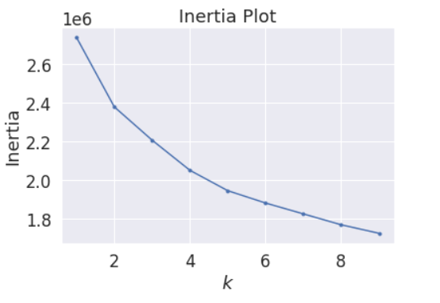
K Means Clustering
K | 2
Accuracy | 0.8117
AUC | 0.5856
Silhouette Score | 0.2945
The Silhouette Score for k = 5 is 0.0880

Slide 36
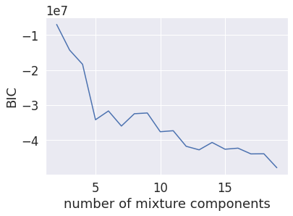
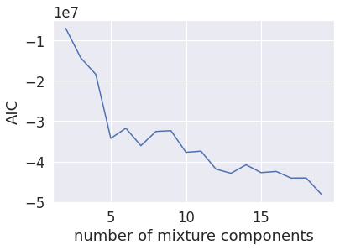
Clustering Algorithms
Algorithm | Accuracy | AUC | Silhouette Score
Mini Batch K Means | 0.7193 | 0.6055 | 0.2075
GMM | 0.8434 | 0.6277 | 0.1572
Birch | 0.8721 | 0.5675 | 0.324
DBSCAN | 0.9325 | 0.5 | 0.281

Slide 37
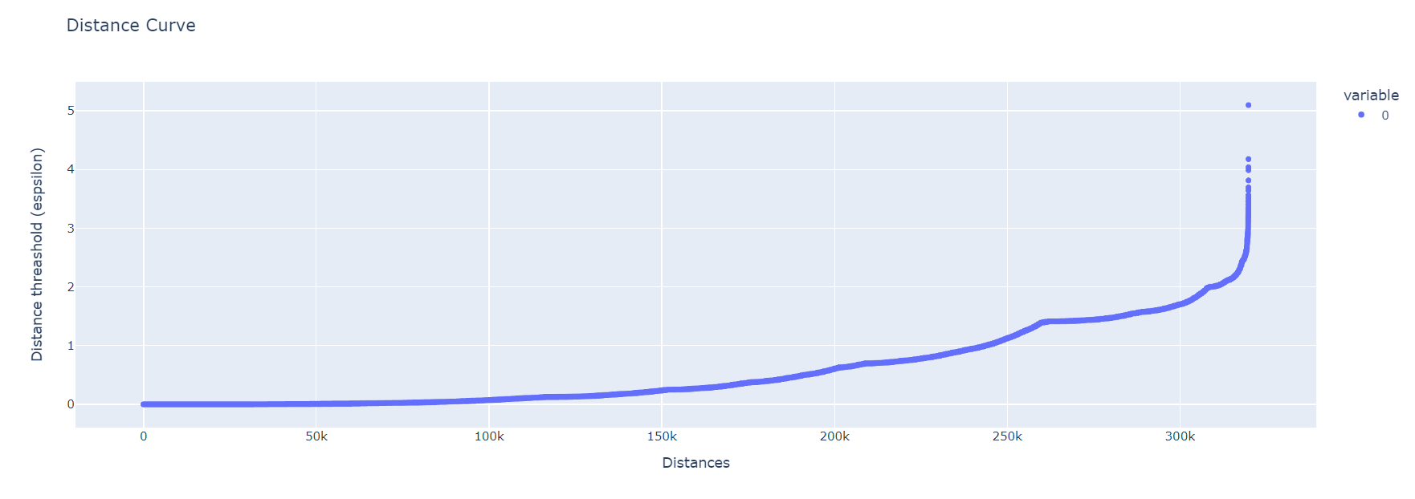
DBScan

Slide 38
Clustering with Outlier Detection
Outlier Algo | Clustering ALgo | Outliers Removed | Accuracy | ROC | Silhouette Score
DBSCAN Eps = 2, minisamples = 75 | Kmeans | 37402 | 0.6324 | 0.5518 | 0.105
Isolation Forest | Kmeans | 36324 | 0.8203 | 0.522 | 0.250
Observation: Agglomerative Clustering, BIRCH and DBSCAN are compute bound algorithms

Slide 39
The Proposal
Easy Prediction of cardiovascular disease using key indicators gathered from surveys

Slide 40
We have you covered
EDA
Split Model
Filter
Uniqueness
Exploring
Ensembling
Insights into Data
Imbalanced features
Outlier Detection and Clustering
Dimensionality Reduction
New unsupervised techniques
~600 model combinations

Slide 41
How we can achieve
Process
Bandwidth
Accuracy
Common evaluation framework helped to make the process smoother
An expert group of ML Engineers
85% accuracy in detection*
*Based on ROC for the Data gathered in US (Year)

Slide 42
Please reach out to us if you have any queries!

Slide 43
Contributions
Jamsheed EDA, Supervised Modelling & Report
Shilpa PCA, Supervised Modelling, base code(supervised) & problem statement research
Ganesh Supervised Modelling
Sourabh Supervised Modelling, Ensembling, DNN
Girish Supervised Modelling
Biswarup Split Modelling and SVM using GPU
Harsha Supervised Modelling
Ajith Outlier Detection, Clustering & problem statement research

